Slide 1
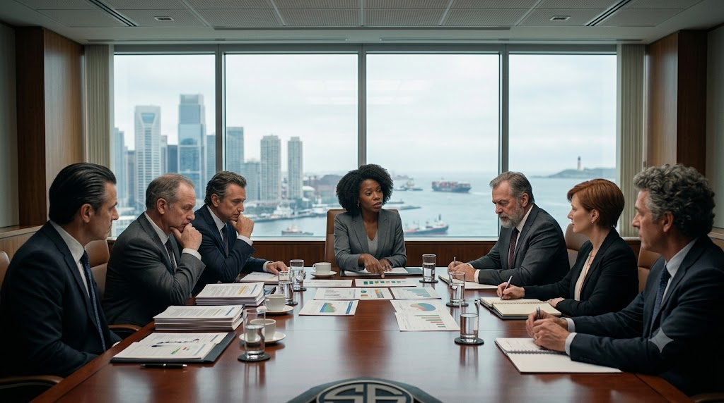
GATE REVIEW BOARD · EXECUTIVE SESSION · 30 APR 2026
Gate 1 —
Recycle Decision
Gate Review Board executive session — the business case as presented does not yet support a GO, and the flaw is correctable. This is the case for a RECYCLE, not a CANCEL and not a conditional GO.
30 Apr 2026
RECYCLE
14.6% → 13.4%
6 Mar 2028
Gate 1 · Executive Session
Recommended Outcome
Corrected IRR (> 11% hurdle)
Launch Date — Held

Slide 2
THE DECISION SPACE
A Gate Has Five Possible Outcomes
Every gate decision picks exactly one of five outcomes on a two-tier test — must-meet knockout criteria first, then a weighted 1–5 score. Tonight's recommendation is RECYCLE.
GO
Proceed to the next stage — funding released.
GO WITH CONDITIONS
Proceed, with binding conditions to close before the next gate.
RECYCLE
Send back to correct a specific, fixable flaw, then re-convene the same gate.
HOLD
Pause — an external dependency must resolve before a decision is meaningful.
CANCEL
Stop the program — the case cannot be made.
2

Slide 3
WHERE WE ARE
Gate 1 Reviews the Validated Business Case
Gate 0 cleared the concept on 5 February (GO, 5-0). Stage 1 built the full business case, and tonight Gate 1 decides whether the validated economics support committing the program to Stage 2 build and filing.
Gate 0
5 Feb 2026 — GO, 5-0 (score 3.85)
Stage 1
The board does not lower the bar to fit the number. Where the model and the evidence disagree, the evidence wins — and tonight they disagree.
Business case built and validated
Tonight
Gate 1 — the GO / conditions / recycle / cancel call
Hurdle
IRR must clear 11.0% to proceed
3

Slide 4
THE CASE AS PRESENTED
What the Package Showed
On its face, the Stage-1 package cleared the bar: a 14.6% IRR against the 11% hurdle, on a five-year premium projection of $1.875B. If those numbers held, this would be a GO.
14.6%
11.0%
$1.875B
9.25%
Preliminary IRR (as presented)
Investment hurdle rate
5-year premium projection
Illustrated cap vs. 9.00% peer
The board's job is to test whether those numbers hold. Two did not.
4

Slide 5
THE FINDINGS
What Gate 1 Found — Two Correctable Flaws
1
Capital charge understated by 87 basis points
The hurdle-rate calculation used a superseded capital charge of 3.33%. The correct figure is 4.2% — an 87-basis-point understatement that flows straight through to the return.
Owner: N. Adeyemi, Chief Actuary
2
Distribution volume never validated with the channel
The premium ramp assumed wholesaler production that was never confirmed with the IMO and wholesaler channel — an assumption, not a commitment.
Owner: R. Castellanos, Head of Distribution
5

Slide 6
THE CORRECTED ECONOMICS
The Number Moves — But Still Clears the Hurdle
AS PRESENTED
CORRECTED
14.6%
13.4%
→
IRR on a 3.33% capital charge and unvalidated distribution volume
IRR on the correct 4.2% capital charge — still above the 11.0% hurdle
The corrected case is still a viable product — which is exactly why the outcome is RECYCLE, not CANCEL.
6

Slide 7
THE REASONING
Why RECYCLE — and Not the Others
Not GO
The number the board would be approving is wrong. Approving a case you know is mis-stated is not governance.
Not conditions
Conditions attach to a sound case. Here the case itself is mis-calculated — that is a correction, not a condition.
Not CANCEL
The corrected 13.4% IRR still clears the 11% hurdle. The product is viable; the paperwork was wrong.
RECYCLE
Send it back, correct the capital charge and validate distribution, and re-convene the same gate on real numbers.
7

Slide 8
THE COST OF THE RECYCLE
The Launch Date Holds — Stage 2 Absorbs the Time
A recycle costs time. The board's choice is to protect the 6 March 2028 launch — the date the market and the filing calendar depend on — and absorb the recycle inside Stage 2 rather than move launch.
6 Mar 2028
46 → 40 wks
~6 weeks
11 Jun 2026
Launch date — HELD
Stage 2 compressed
Absorbed, not added to the end
Gate 1 re-convenes
Root cause is a sequencing failure in the business-case build — the Chair's to own, and to fix in how the next case is assembled.
8

Slide 9
THE RECOMMENDATION
Recommendation: RECYCLE
1
Correct the capital charge to 4.2% and re-run the return — expected IRR 13.4%, above the 11% hurdle.
2
Validate distribution volume with the IMO and wholesaler channel before re-convening.
3
Hold the 6 March 2028 launch; absorb the recycle by compressing Stage 2 from 46 to 40 weeks.
4
Re-convene Gate 1 on 11 June 2026 to decide on the corrected case.
9

Slide 10
THE RECYCLE CHANGED THE ANSWER,
NOT THE PAPERWORK.
A gate that only ever says GO is not a gate. This one did its job.
10

